Slide 1
Classification MEthods
Chapter 04 (part 01)

Slide 2

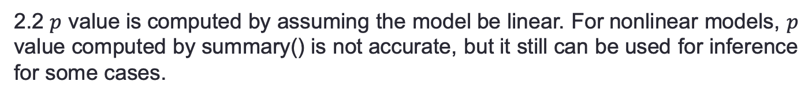
Review of Linear Regression
1. Generalized Linear Model
$$Y=β_{0}+β_{1}f_{1}\left(X_{1}\right)+⋯+β_{p}f_{p}\left(X_{p}\right)+ε$$
$$Y=β_{0}+β_{1}Z_{1}+β_{2}Z_{2}⋯+β_{p}Z_{p}+ε, ε\sim N(μ,σ)$$
If p is small, you can use I() function in R to denote $f_{i}(X_{i})$ as a variable in lm().
If p is large, you may directly compute matrix Z of which the i-th column is $f_{i}(X_{i})$
2. Hypothesis test
2.1 $p$ value is used to test whether $β_{i}$(s) are 0.
2.2 $p$ value is computed by assuming the model be linear. For nonlinear models, $p$ value computed by summary() is not accurate, but it still can be used for inference for some cases.
2.3 F-test on a single variable is equivalent to t-test, given all variables.
2.4 $p$ value may be not significant for linear models with no “useful” variables.

Slide 3

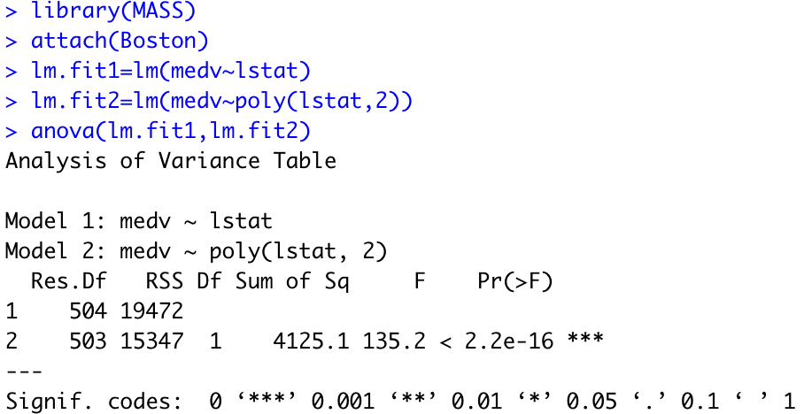
3. Useful R functions
shows the coefficients, $R^{2}$, p values on t-test and F-test, etc.
plots legend in the figure
tests whether the differences of RSS between two models are significant.

Slide 4
Case 1: Brand Preference for Orange Juice
We would like to predict what customers prefer to buy: Citrus Hill or Minute Maid orange juice?
The Y (Purchase) variable is categorical: 0 or 1
The X (LoyalCH) variable is a numerical value (between 0 and 1) which specifies the how much the customers are loyal to the Citrus Hill (CH) orange juice
Can we use Linear Regression when Y is categorical?

Slide 5
Why not Linear Regression?
When Y only takes on values of 0 and 1, why standard linear regression in inappropriate?
0.9
How do we interpret values greater than 1?
0.7
Purchase
0.5
0.4
0.2
How do we interpret values of Y between 0 and 1?
0.0
.0
.1
.2
.3
.4
.5
.6
.7
.8
.9
1.0
LoyalCH

Slide 6
Problems
The regression line β₀+β₁X can take on any value between negative and positive infinity
In the orange juice classification problem, Y can only take on two possible values: 0 or 1.
Therefore the regression line almost always predicts the wrong value for Y in classification problems

Slide 7
Solution: Use Logistic Function
Instead of trying to predict Y, let’s try to predict P(Y = 1), i.e., the probability a customer buys Citrus Hill (CH) juice.
Thus, we can model P(Y = 1) using a function that gives outputs between 0 and 1.
We can use the logistic function
Logistic Regression!

Slide 8
Logistic Regression
Logistic regression is very similar to linear regression
We estimate β₀ and β₁.
We have similar problems and questions as in linear regression
e.g. Is β₁ equal to 0? How sure are we about our guesses for β₀ and β₁?
1
CH
0.75
0.5
P(Purchase)
MM
0.25
0
.0
.2
.4
.6
.7
.9
LoyalCH
If LoyalCH is about .6 then Pr(CH) ≈ .7.

Slide 9
Case 2: Credit Card Default Data
We would like to be able to predict customers that are likely to default
Possible X variables are:
Annual Income
Monthly credit card balance
The Y variable (Default) is categorical: Yes or No
How do we check the relationship between Y and X?

Slide 10
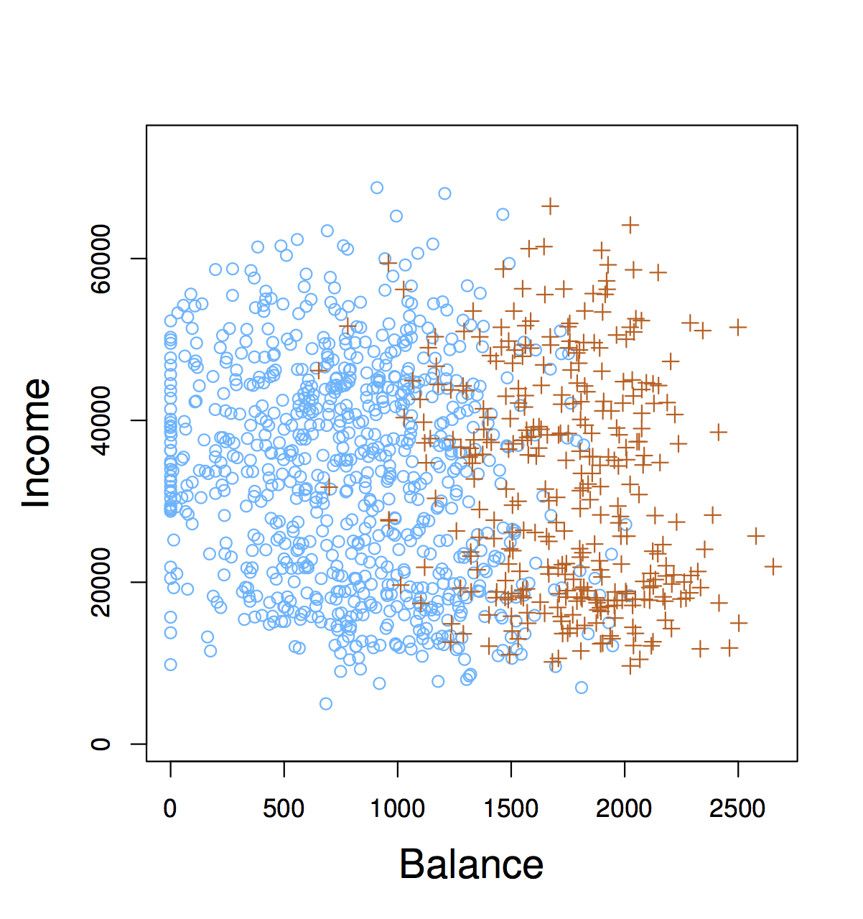
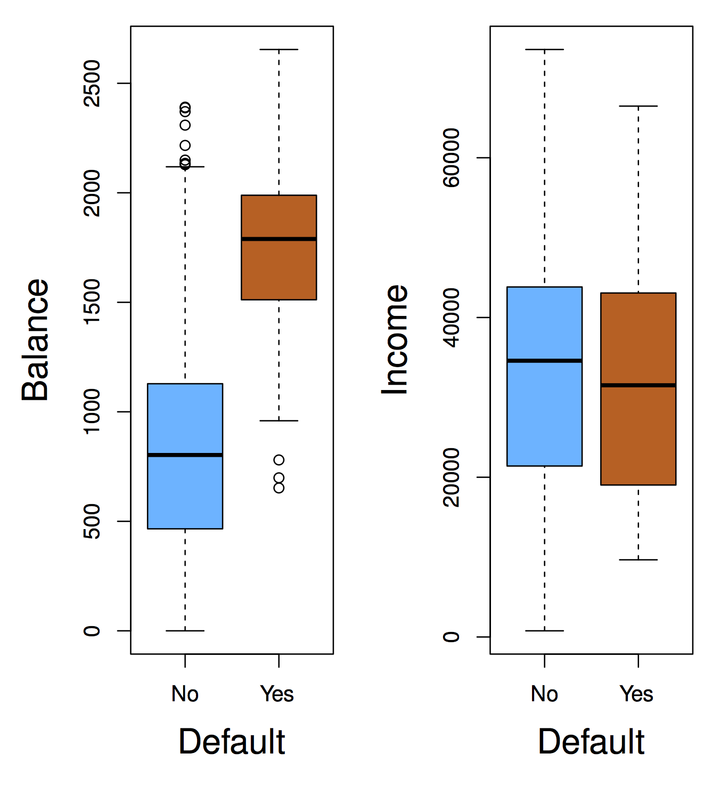
The Default Dataset

Slide 11
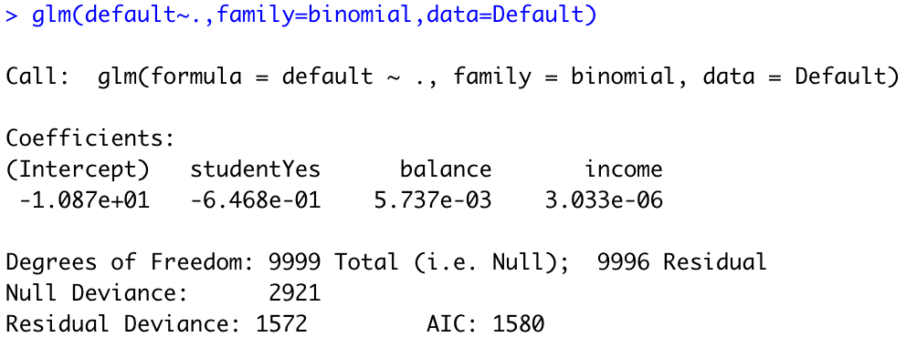
Logistic Regression in R

Slide 12
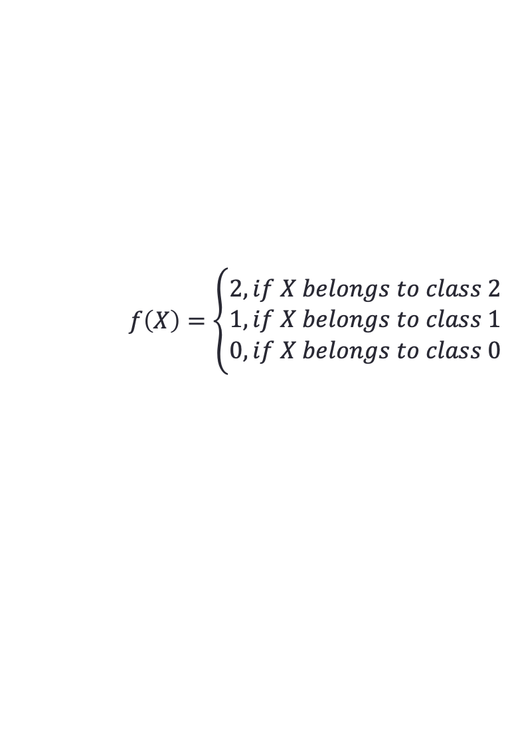
Concerns on Multiclass Classification
For a two-class classification problem, we can denote one class as 0 and the other one as 1. If we get three classes, how to denote each class?
Intuitively, we can use 0, 1 and 2 to denote the classes. However, such denotation forces class 2 and 0 to be more important than classes 1.
Suppose we design a parameterized function
$$f\left(X\right)=\left\{\begin{aligned}2, if X belongs to class 2 \\ 1, if X belongs to class 1 \\ 0, if X belongs to class 0\end{aligned}\right.$$
We use least squares to fit the data and find out the parameters of $f(X)$. To be simplified, we use three data points $\left(X_{0},0\right), \left(X_{1},1\right), (X_{2},2)$. The MSE is
$${\left(f\left(X_{0}\right)−0\right)}^{2}+{\left(f\left(X_{1}\right)−1\right)}^{2}+{\left(f\left(X_{2}\right)−2\right)}^{2}$$

Slide 13
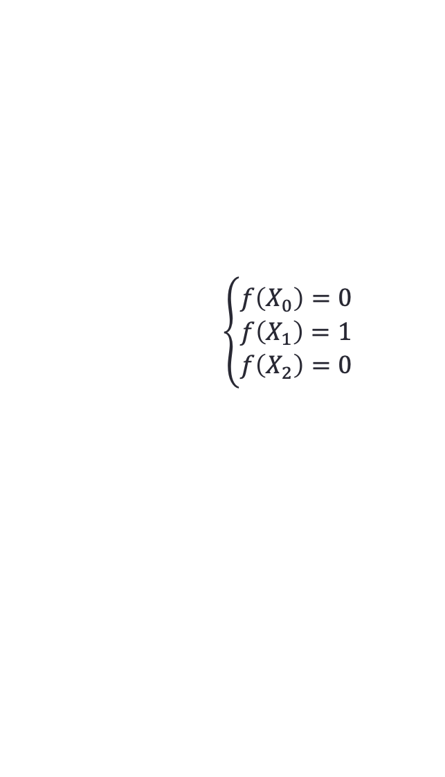



$${\left(f\left(X_{0}\right)−0\right)}^{2}+{\left(f\left(X_{1}\right)−1\right)}^{2}+{\left(f\left(X_{2}\right)−2\right)}^{2}$$
Let us assume there be a misclassification on class 2, e.g.
$$\left\{\begin{aligned}f\left(X_{0}\right)=0 \\ f\left(X_{1}\right)=1 \\ f\left(X_{2}\right)=0\end{aligned}\right.$$
In this case, the MSE is 4. A misclassification on class 0 may also cause an increase of 4 on MSE. However, a misclassification on class 1 only can cause an increase of 1 on MSE.
The model indicates misclassification on class 1 is not as important as misclassifications on classes 0 and 2.
Hence, to classify data of more than 2 classes, we use 1-hot vector to indicate their categories.
$$\left[\begin{matrix}1 \\ 0 \\ 0\end{matrix}\right]$$
$$\left[\begin{matrix}0 \\ 1 \\ 0\end{matrix}\right]$$
$$\left[\begin{matrix}0 \\ 0 \\ 1\end{matrix}\right]$$
Class 0
Class 1
Class 2
Logistic regression has multi-class extensions, but they are few used because we have better tools.

Slide 14
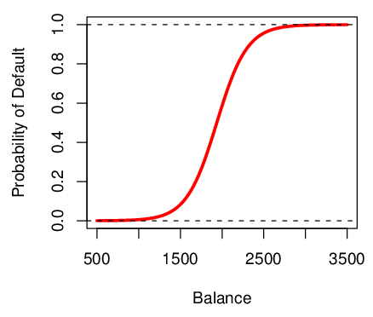
Logistic Function on Default Data
Now the probability of default is close to, but not less than zero for low balances. And close to but not above 1 for high balances

Slide 15

Are the coefficients significant?
We still want to perform a hypothesis test to see whether we can be sure that are β₀ and β₁ significantly different from zero.
We use a Z test instead of a T test, but of course that doesn’t change the way we interpret the p-value
Here the p-value for balance is very small, and β₁ is positive, so we are sure that if the balance increase, then the probability of default will increase as well.

Slide 16

Making Prediction
Suppose an individual has an average balance of $1000. What is their probability of default?
The predicted probability of default for an individual with a balance of $1000 is less than 1%.
For a balance of $2000, the probability is much higher, and equals to 0.586 (58.6%).

Slide 17
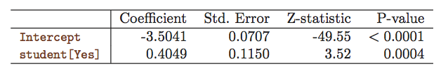
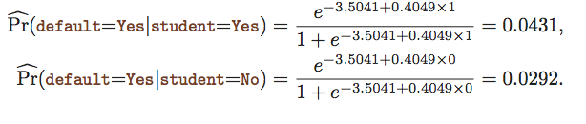
Qualitative Predictors in Logistic Regression
We can predict if an individual default by checking if she is a student or not. Thus we can use a qualitative variable “Student” coded as (Student = 1, Non-student =0).
β₁ is positive: This indicates students tend to have higher default probabilities than non-students

Slide 18

Multiple Logistic Regression
We can fit multiple logistic just like multiple linear regression

Slide 19
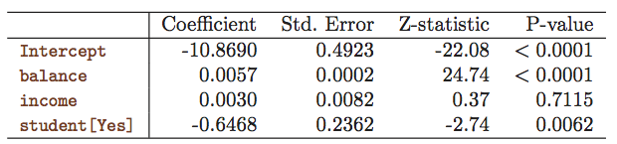
Multiple Logistic Regression- Default Data
Predict Default using:
Balance (quantitative)
Income (quantitative)
Student (qualitative)

Slide 20

Predictions
A student with a credit card balance of $1,500 and an income of $40,000 has an estimated probability of default

Slide 21
An Apparent Contradiction!
Positive
Negative

Slide 22
To whom should credit be offered?
A student is risker than non students if no information about the credit card balance is available
However, that student is less risky than a non student with the same credit card balance!

Slide 23

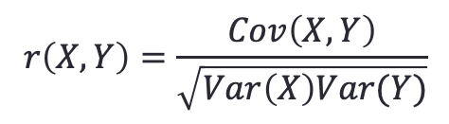
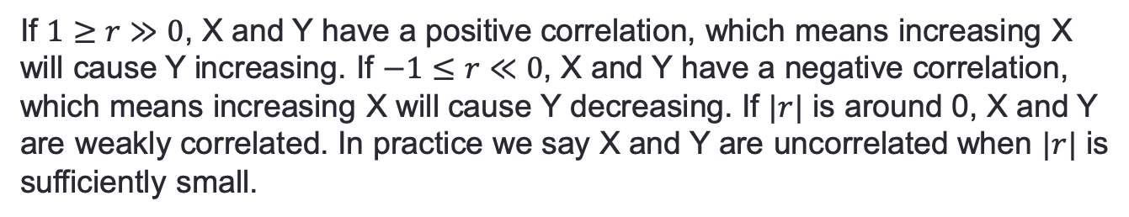

Correlation
If we want to predict the stock price of a company, income and profit may be highly correlated variables. Generally, higher income results in higher profit. How can we evaluate the correlation between two variables?
$$r\left(X,Y\right)=\frac{Cov\left(X,Y\right)}{\sqrt{Var\left(X\right)Var(Y)}}$$
Correlation Coefficient:
Covariance:
$$Cov\left(X,Y\right)=E\left(\left(X−E\left(X\right)\right)\left(Y−E\left(Y\right)\right)\right)$$
Variance:
$$Var\left(X\right)=E\left({\left(X−E\left(X\right)\right)}^{2}\right)$$
If $1≥r≫0$, X and Y have a positive correlation, which means increasing X will cause Y increasing. If $−1≤r≪0$, X and Y have a negative correlation, which means increasing X will cause Y decreasing. If $|r|$ is around 0, X and Y are weakly correlated. In practice we say X and Y are uncorrelated when $|r|$ is sufficiently small.

Slide 24
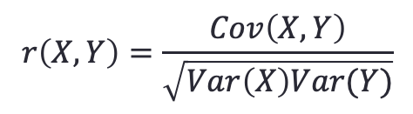
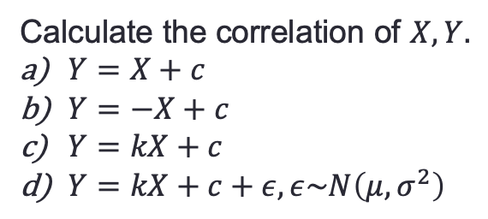
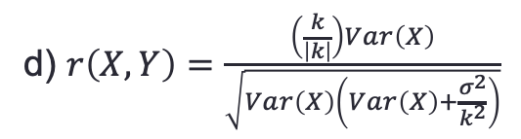



Example 1. Correlation
Calculate the correlation of $X, Y.$
$Y=X+c$
$Y=−X+c$
$Y=kX+c$
$Y=kX+c+ε, ε\sim N\left(μ,σ^{2}\right)$
$$r\left(X,Y\right)=\frac{Cov\left(X,Y\right)}{\sqrt{Var\left(X\right)Var(Y)}}$$
a)
$$r\left(X,Y\right)=1$$
b) $r\left(X,Y\right)=−1$
c) $r\left(X,Y\right)=\frac{k}{\left|k\right|}$
d) $r\left(X,Y\right)=\frac{\left(\frac{k}{\left|k\right|}\right)Var\left(X\right)}{\sqrt{Var\left(X\right)\left(Var\left(X\right)+\frac{σ^{2}}{k^{2}}\right)}}$

Slide 25

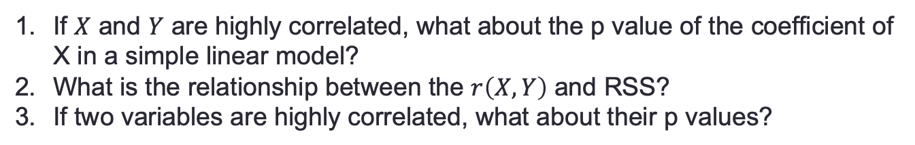
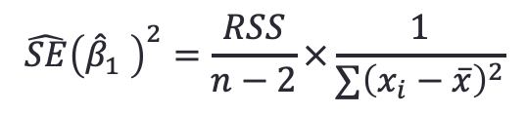
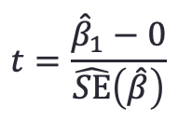
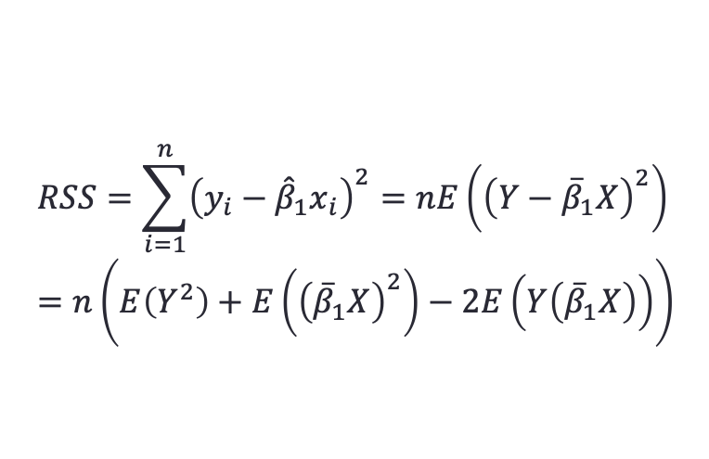
Example 2. Understanding P value and Correlation
If $X$ and $Y$ are highly correlated, what about the p value of the coefficient of X in a simple linear model?
What is the relationship between the $r\left(X,Y\right)$ and RSS?
If two variables are highly correlated, what about their p values?
SOLUTION
$$t=\frac{{\hat{β}}_{1}−0}{\hat{SE}\left(\hat{β}\right)}$$
$$\hat{SE}{\left({\hat{β}}_{1} \right)}^{2}=\frac{RSS}{n−2}×\frac{1}{∑{\left(x_{i}−\overline{x}\right)}^{2}}$$
1.
$$RSS↓⇒\hat{SE}\left(\hat{β}\right)↓⇒t↑⇒p value↓$$
$$RSS=\sum_{i=1}^{n}{{\left(y_{i}−{\hat{β}}_{1}x_{i}\right)}^{2}=nE\left({\left(Y−{\overline{β}}_{1}X\right)}^{2}\right)} \\ =n\left(E\left(Y^{2}\right)+E\left({\left({\overline{β}}_{1}X\right)}^{2}\right)−2E\left(Y\left({\overline{β}}_{1}X\right)\right)\right)$$
2.
$E\left(Y\left({\overline{β}}_{1}X\right)\right)={\overline{β}}_{1}E\left(XY\right)=$ ${\overline{β}}_{1}\left(Cov\left(X,Y\right)+E\left(X)E(Y\right)\right)$

Slide 26
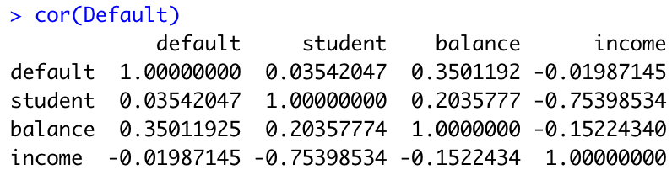
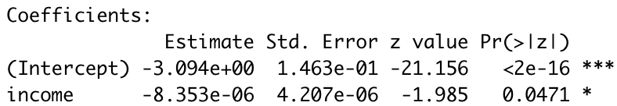
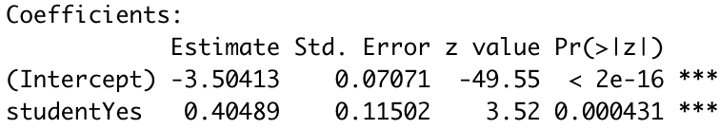
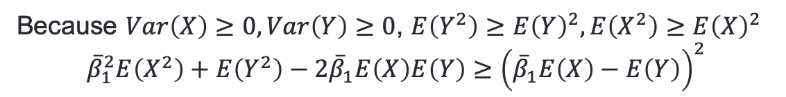
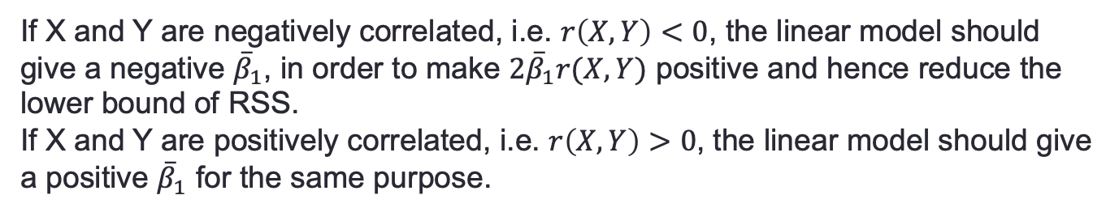
$$RSS=n\left(E\left(Y^{2}\right)+{\overline{β}}_{1}^{2}E\left(X^{2}\right)−2{\overline{β}}_{1}Cov\left(X,Y\right)−2{\overline{β}}_{1}E\left(X\right)E\left(Y\right)\right)$$
$$E\left(Y^{2}\right)−E{\left(Y\right)}^{2}=Var\left(Y\right), E\left(X^{2}\right)−E{\left(X\right)}^{2}=Var(X)$$
Because $Var\left(X\right)≥0, Var\left(Y\right)≥0$, $E\left(Y^{2}\right)≥E{\left(Y\right)}^{2}, E\left(X^{2}\right)≥E{\left(X\right)}^{2}$
$${\overline{β}}_{1}^{2}E\left(X^{2}\right)+E\left(Y^{2}\right)−2{\overline{β}}_{1}E\left(X\right)E\left(Y\right)≥{\left({\overline{β}}_{1}E\left(X\right)−E\left(Y\right)\right)}^{2}$$
$$RSS≥n\sqrt{Var\left(X\right)Var\left(Y\right)}(“something≥0”−2{\overline{β}}_{1}r\left(X,Y\right))$$
If X and Y are negatively correlated, i.e. $r\left(X,Y\right)<0$, the linear model should give a negative ${\overline{β}}_{1}$, in order to make $2{\overline{β}}_{1}r(X,Y)$ positive and hence reduce the lower bound of RSS.
If X and Y are positively correlated, i.e. $r\left(X,Y\right)>0$, the linear model should give a positive ${\overline{β}}_{1}$ for the same purpose.
Default~income
Default~student

Slide 27
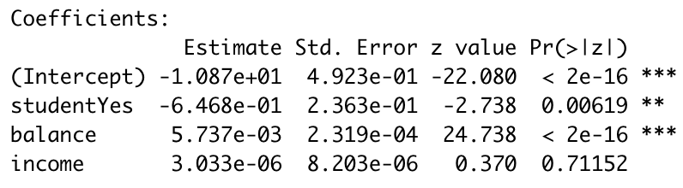
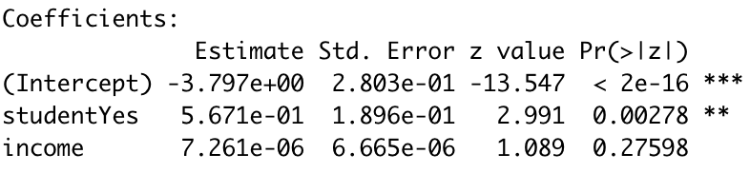
3.
Why contradictory?

Slide 28
Exercise in R
Default dataset. Use a logistic regression model to predict default by considering the interaction between student and balance.
Default dataset. Predict default using logistic regression using polynomials of balance variable.
Use summary() to investigate your fitted model and try to explain those values.

Slide 29
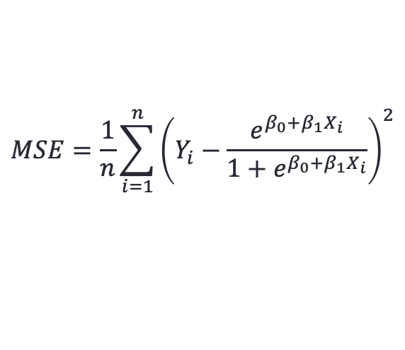
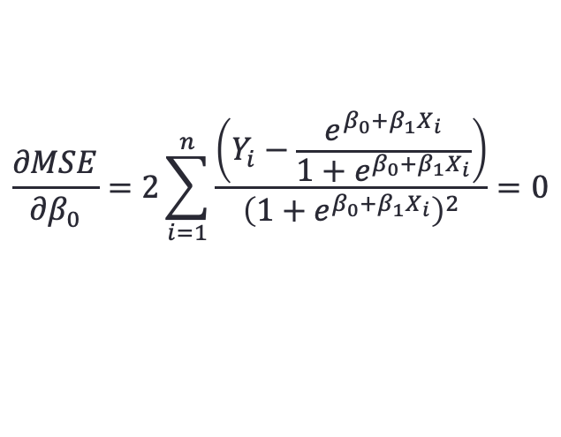
How to minimize the MSE of logistic regression? (optional)
$$MSE=\frac{1}{n}\sum_{i=1}^{n}{{\left(Y_{i}−\frac{e^{β_{0}+β_{1}X_{i}}}{1+e^{β_{0}+β_{1}X_{i}}}\right)}^{2}}$$
Is setting partial derivatives to 0 tractable?
$$\frac{∂MSE}{∂β_{0}}=2\sum_{i=1}^{n}{\frac{\left(Y_{i}−\frac{e^{β_{0}+β_{1}X_{i}}}{1+e^{β_{0}+β_{1}X_{i}}}\right)}{{\left(1+e^{β_{0}+β_{1}X_{i}}\right)}^{2}}=0}$$
You cannot find an analytic solution to the above equation. Therefore, Gradient Descent is used to minimize MSE.

Slide 30
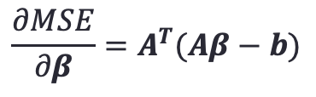









Gradient Descent
$$j$$
$$x_{1}←x_{0}−Δt\frac{dy}{dx}{\left.​\right|}_{x_{0}}$$
$$i$$
$$x_{1}$$
$$x_{0}$$
One dimension: gradient: $\frac{∂Y}{∂X}i$
Two dimension: gradient: $\frac{∂Z}{∂X}i+\frac{∂Z}{∂Y}j$
Minimizing MSE of linear regression model.
$$Aβ=b$$
$$\underset{β}{arg min}{{MSE=\left\|Aβ−b\right\|}^{2}}$$
$$\frac{∂MSE}{∂β}=A^{T}(Aβ−b)$$

Slide 31
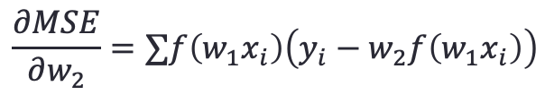






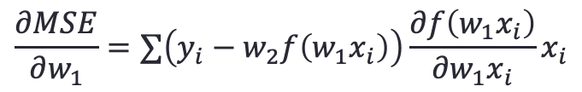
Back-propagation and Forward-propagation (optional)
Back-propagation and forward-propagation are two terms used in training artificial neural networks.
$${f(w}_{1}x)$$
$$x$$
$$w_{2}h_{1}$$
$$y$$
Forward-propagation:
$$y={w_{2}f(w}_{1}x)$$
$$\underset{w_{1},w_{2}}{arg min}{MSE=∑{\left(y_{i}−w_{2}f(w_{1}x_{i})\right)}^{2}}$$
$$\frac{∂MSE}{∂w_{2}}=∑f\left(w_{1}x_{i}\right)\left(y_{i}−w_{2}f\left(w_{1}x_{i}\right)\right)$$
$$\frac{∂MSE}{∂w_{1}}=∑\left(y_{i}−w_{2}f\left(w_{1}x_{i}\right)\right)\frac{∂f\left(w_{1}x_{i}\right)}{∂w_{1}x_{i}}x_{i}$$
Error
Output of the previous layer, i.e. input layer
Output of the previous layer
Error
The error are back-propagated to the first layer.

Slide 32
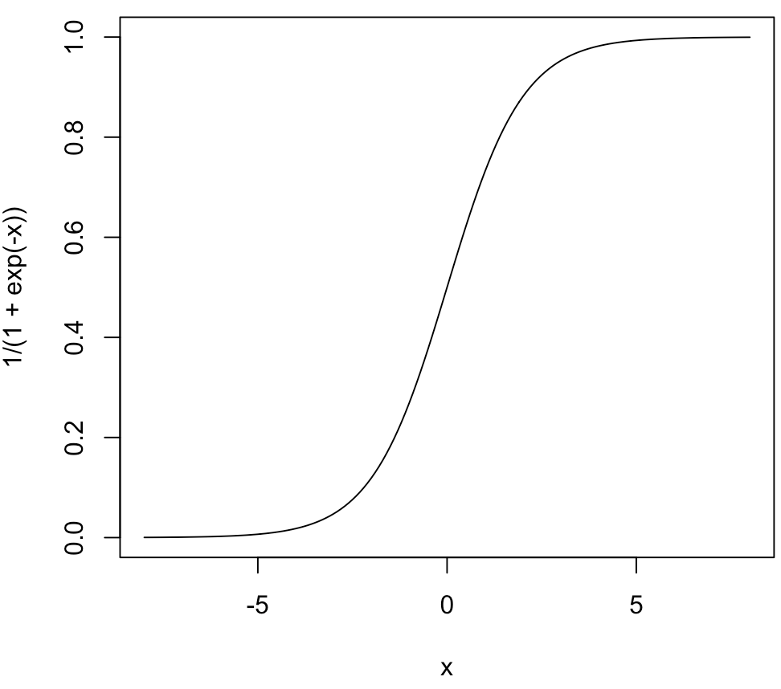
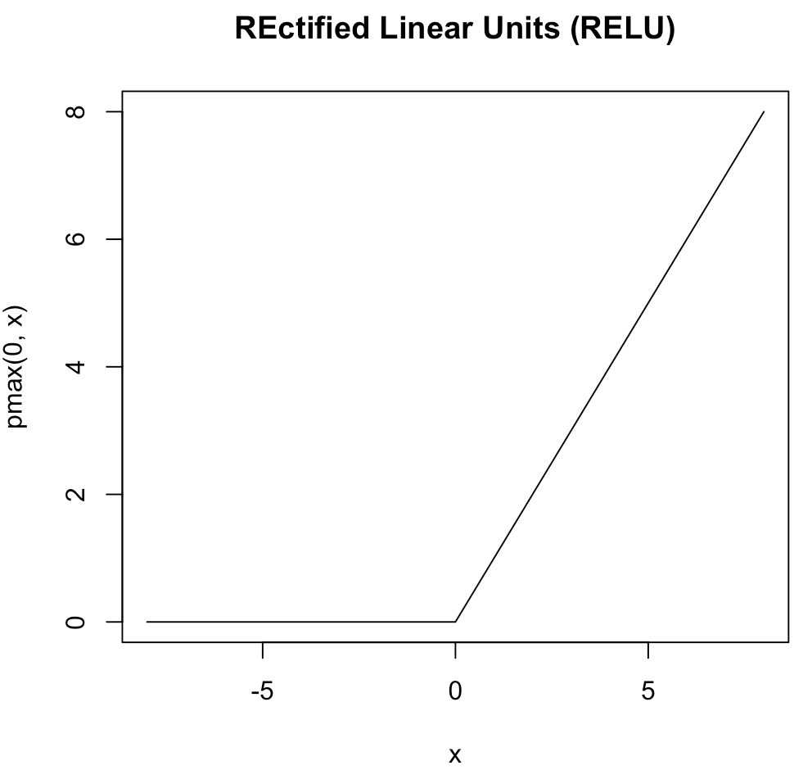
Deep Neural Network and Gradient Vanishing (optional)
When the output of a layer goes to these regions, the gradients become too small. It is difficult for the optimizer to approach the minimum.

Slide 33
Global Optimum VS Local Optimum (optional)
Local minima
Global minimum
Almost all numerical optimization algorithms can only converge to a local minimum for nonconvex function.

Slide 34
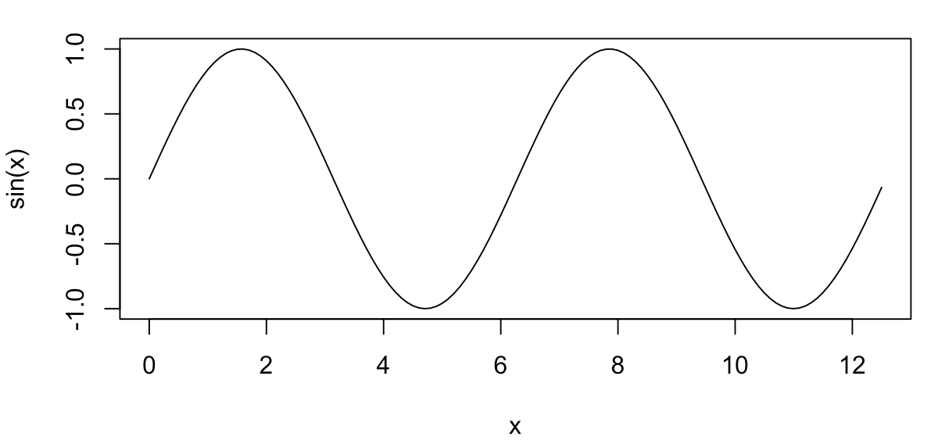



Exercise (Optional)
Try to minimize the following object function by gradient descent in R
$$y=\sin\left(x\right), x∈(0,4π)$$
$$x=1.5π,y=−1$$
$$x=3.5π,y=−1$$

